Slide 1
Department of Masters Of Computer Applications
A Project Report
On
Spam detection on mobile phone Short Message Service (SMS) performance using FP-growth and Naive Bayes Classifier
Under the Guidance of
Assistant Professor
Project By
N. Sri

Slide 2
Spam detection on mobile phone
Short Message Service (SMS) performance using FP-growth and
Naive Bayes Classifier
BY
N.Saravana

Slide 3
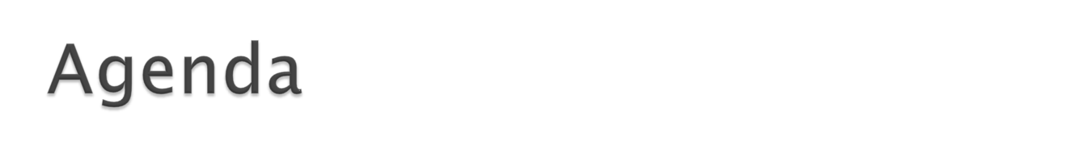
Abstract
Problem Definition
Existing System
Proposed System
System Requirements
Module Description
System Architecture
UML Diagrams
Result
Conclusion

Slide 4
Abstract:
SMS (Short Message Service) is still the primary choice as a communication medium even though nowadays mobile phone is growing with a variety of communication media messenger applications. However, nowadays along with the SMS tariff reduction leads to the increase of SMS spam, as used by some people as an alternative to advertise and fraud. Therefore, it becomes an important issue as it can bug and harm the users and one of its solutions is with automatic SMS spam filtering.
One of most challenging in SMS spam filtering is its accuracy. In this research we proposed to enhance SMS spam filtering performance by combining two of data mining task association and classification. FP-growth in association is utilized for mining frequent pattern on SMS and Naive Bayes Classifier is used to classify whether SMS is spam or ham. Training data was using SMS spam collection from previous research. The result of using collaboration of Naive Bayes and FP-Growth performs the highest average accuracy of 90%.FP-Growth for dataset SMS Spam Collection and improves the precision score; thus, the classification result is more accurate.

Slide 5
Problem Definition:
SMS is a text-based communication media that allows mobile phone users to share a short text. Along with the widespread use and popularity as the most important communications media, there are plenty of those who use it for commercial purposes such as advertising media and even fraud. The reduced SMS rate is one of the causes of increasing SMS spam. When we receive any SMS/Mails if may be either HAM (Important messages) or SPAM (least important messages). But sometimes SPAM messages divert our mind. So we need such system which can either block the SPAM message as either it move the SPAM message into different folder without disturbing USER.

Slide 6
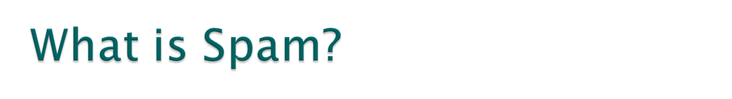
Spam is flooding the Internet with many copies of the same message, in an attempt to force the message on people who would not otherwise choose to receive it. Most spam is commercial advertising, often for dubious products, get-rich-quick schemes, or quasi-legal services. Spam costs the sender very little to send -- most of the costs are paid for by the recipient or the carriers rather than by the sender.

Slide 7
Examples of spam/ham:
HAM: Hi this is Saravana how are you abhi……….
HAM: I‰Û÷m going to try for 2 months ha ha only joking
SPAM: Free Entry in 2K weekly comes to win 2L for monthly enroll your name.
SPAM: 07732584351 - Rodger Burns - MSG = We tried to call you re your reply to our sms for a free nokia mobile + free camcorder.
Please call now 08000930705 for delivery tomorrow
HAM: Tomorrow have review to me in my college I am coming to tirupati.
.
HAM: ok come let’s meet here bye….
SPAM:SMS. ac Sptv: The New Jersey Devils and the Detroit Red Wings play Ice Hockey. Correct or Incorrect? End? Reply END SPTV

Slide 8
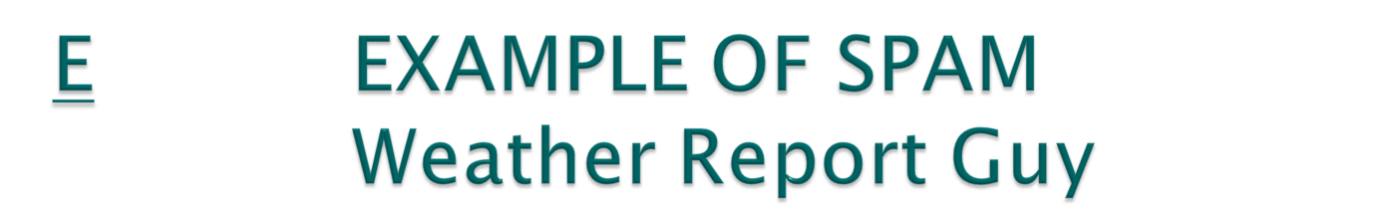


Content in Image
Weather, Sunny, High 82, Low 81, Favorite…

Slide 9



Another spam that looks easy
Is it?

Slide 10
Existing System:
Now a day’s true caller is that existing system which can block these senders message whose messages are annoying you but we have a control over the sender but not ones the type of messages. So we need such technology/system which can block the particular kind of messages.
Disadvantages:
Suppose it a user don’t want any promotional message and it he knows which all users can send him these kinds of messages then he/she can block these senders.
But if these blocked users any informational message to the user then user will not be able to receive the message.

Slide 11
Proposed system:
We are using Machine Learning algorithm (Naïve Bayes Algorithm) to eradicate such problem. In this algorithm model will train the machine by its 70% and 30% of dataset. Through this 70% data our machine will be trained enough to decide which is the SPAM message or which is the HAM message.
Advantages :
  we can easily block the unnecessary messages compare to existing system. Then the proposed system will distinguish between SPAM & HAM.
  we are not supposed to block the users we can just oppose or block that type of least important message without blocking the user. So the users can send any important message.

Slide 12
SYSTEM REQUIREMENTS:
Hardware requirements:
System : Intel CORE i3
Hard Disk : 40 GB.
Floppy Drive : 1.44 Mb.
Monitor : 15 VGA Colour.
Mouse : Logitech.
Ram : 2GB.
Software requirements:
Operating system : Windows 7/8/10
Coding Language : Python
IDE : Anaconda(spyder, Jupiter), Python IDLE 2.7/3.6
Database : CSV File, TSV File.

Slide 13
MODULE DESCRIPTION:
Importing the Libraries
Load Data sets
Data Preprocessing
Feature Extraction (FP-Growth)
Vector Creation
Classification
Naïve Bayes Algorithm
Finding the accuracy
Output

Slide 14
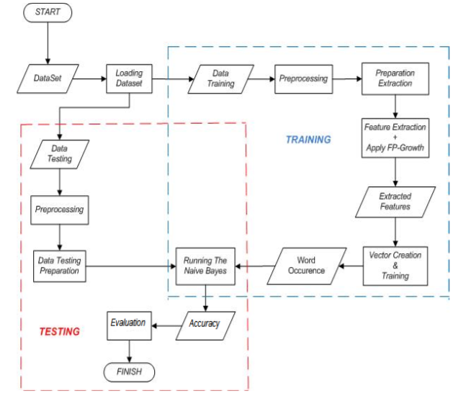
System Architecture

Slide 15
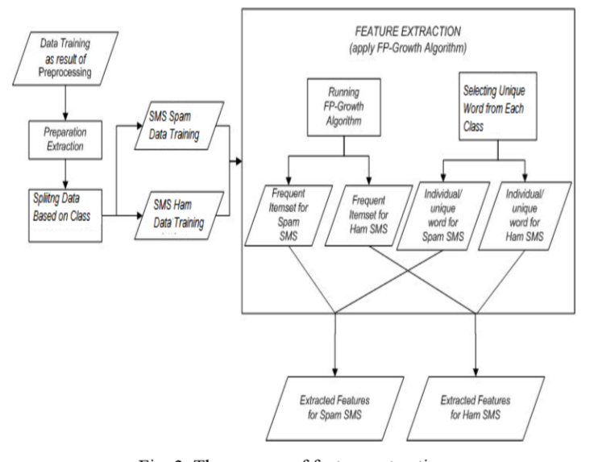
Feature Extraction

Slide 16
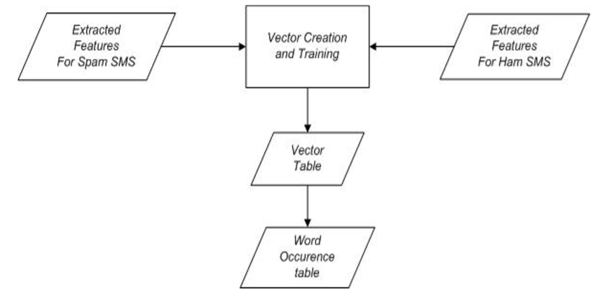
Vector Creation and Training

Slide 17
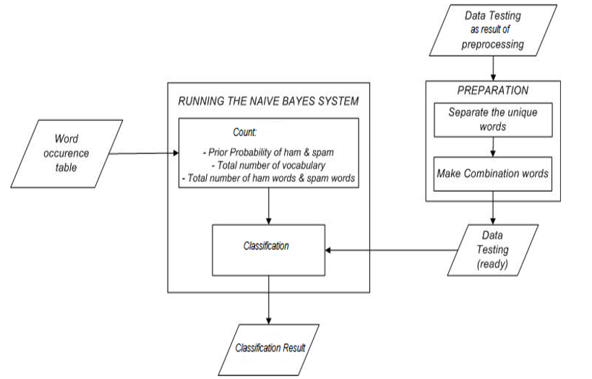
Running the Naive Bayes System

Slide 18
Naïve Bayes Algorithm
Want to find p(spam/ham)
Use Bayes Rule:
To find the probability
1.P(spam/yes)=p(yes/spam)*p(yes)
p(spam)
2.p(spam/no)=p(no/spam)*p(no)
p(no)
Assume independence: probability of each word independent of others

Slide 19
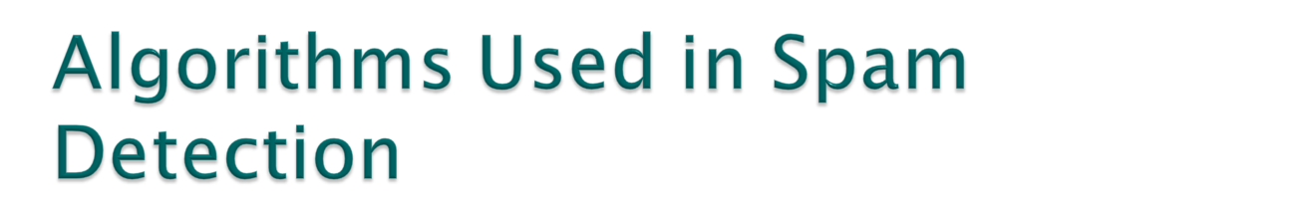
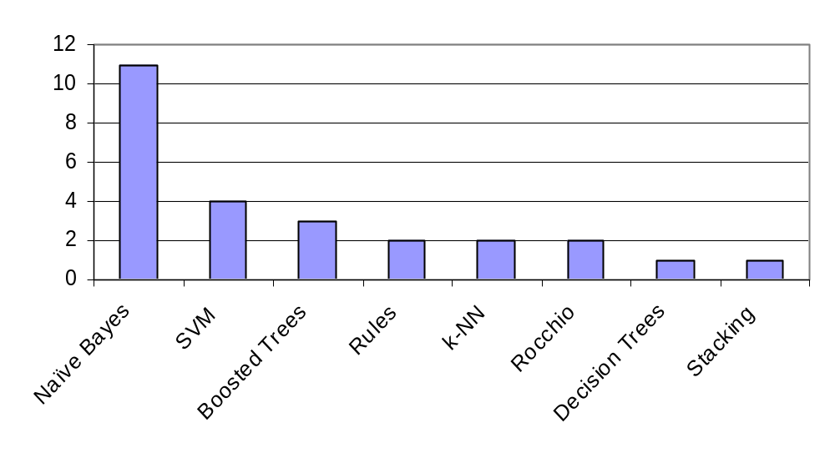
Naïve Bayes reported to do very well
More complex algorithms have some gain

Slide 20
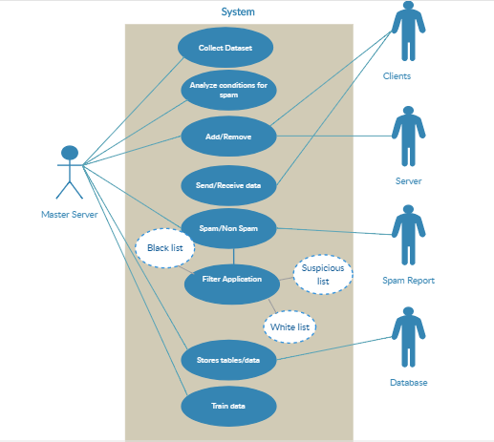
UML DIAGRAMS
USECASE DIAGRAM

Slide 21
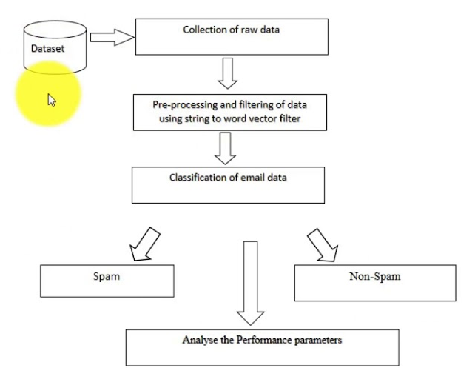
Activity diagram

Slide 22
Collaboration Diagram
Sender
1: send message
System
2: Compare the training data
5: Receive the Message
3: Use Naïve Bayes Algorithm Check Probability
4: Check the probability either which is great
Receiver

Slide 23
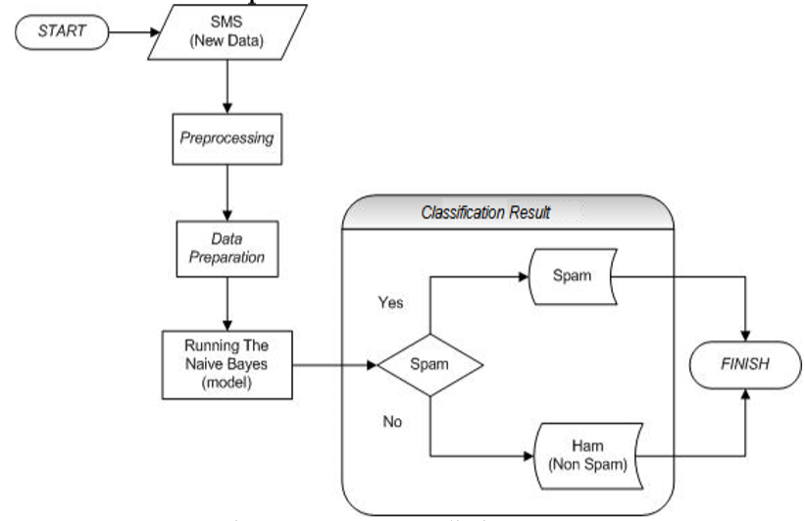
New SMS prediction process:

Slide 24
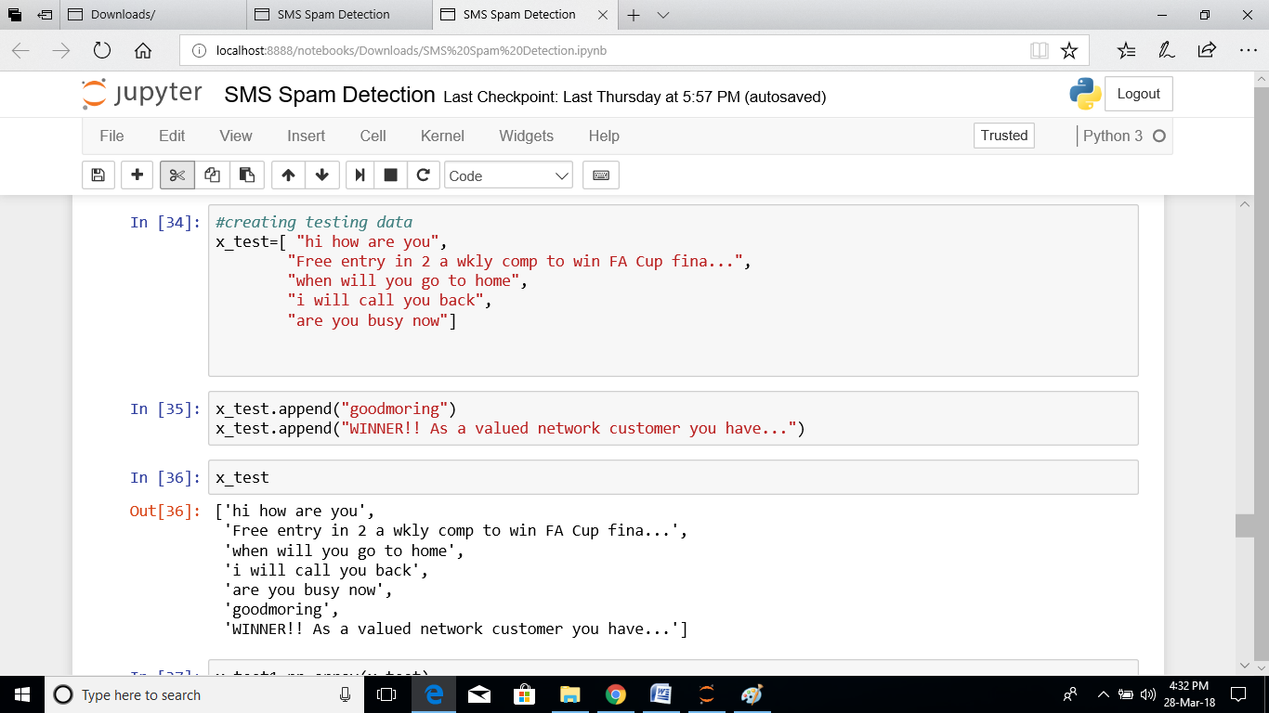
New Input Data

Slide 25
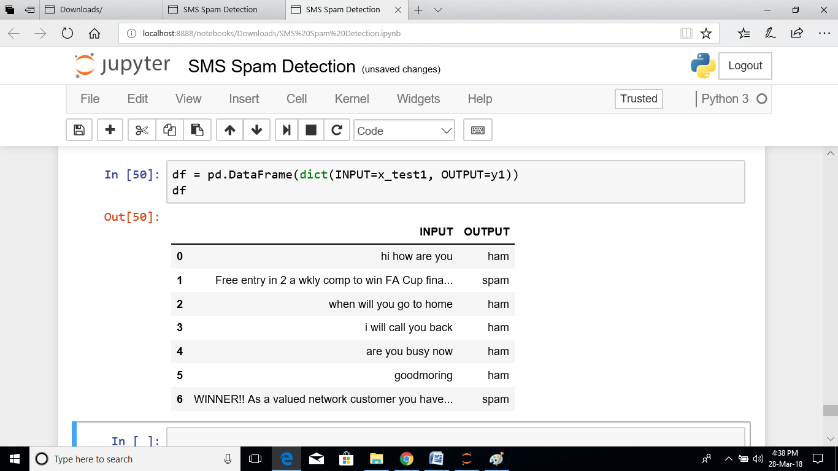
Output of our project

Slide 26
CONCLUSION
Based on the analysis of the tests performed in this research, it can be concluded that:
Both methods used in this research, the performances of both methods is equally well for SMS classification with average of the accuracy above 90%. The use of collaboration methods, Naive Bayes and FP-Growth, is superior to the average accuracy for each dataset.
The Accuracy best average is obtained when the SMS Spam Collection v.1 dataset with the 9%minimum support is used and the implementation of the FP-Growth has accuracy up to 98.506%.
The use of datasets with varied training data is agreeable to be applied by using the FP-Growth. By implementing the FP-Growth for feature extraction, it can elevate the score of precision. Thus, the system becomes more precise in providing the information requested by the users in response to the SMS classification.

Slide 27

REQUERMENTS
HARDWARE REQUIREMENTS:
RAM :- 4GB
HARD DISK :- 1TB
PROCESSOR :- Intel Pentium IV 2.4 GHz
SOFTWARE REQUIREMENTS:
OPERATING SYSTEM :- Windo

